Slide 1
Area x*y

Slide 2
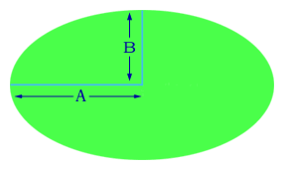
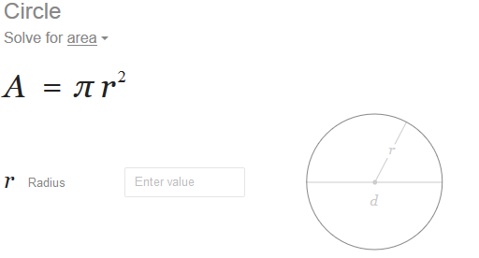
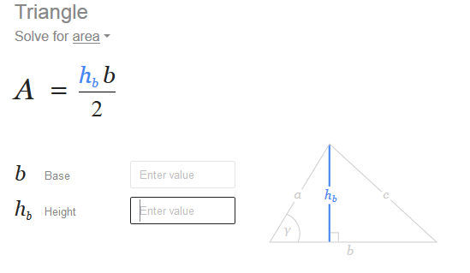
Ellipse
Area = Pi * A * B ,
Cut in ½ and combine area
of 2 triangles ( ½ bh)x2

